Slide 1
Utility Monitoring Solution

Slide 2
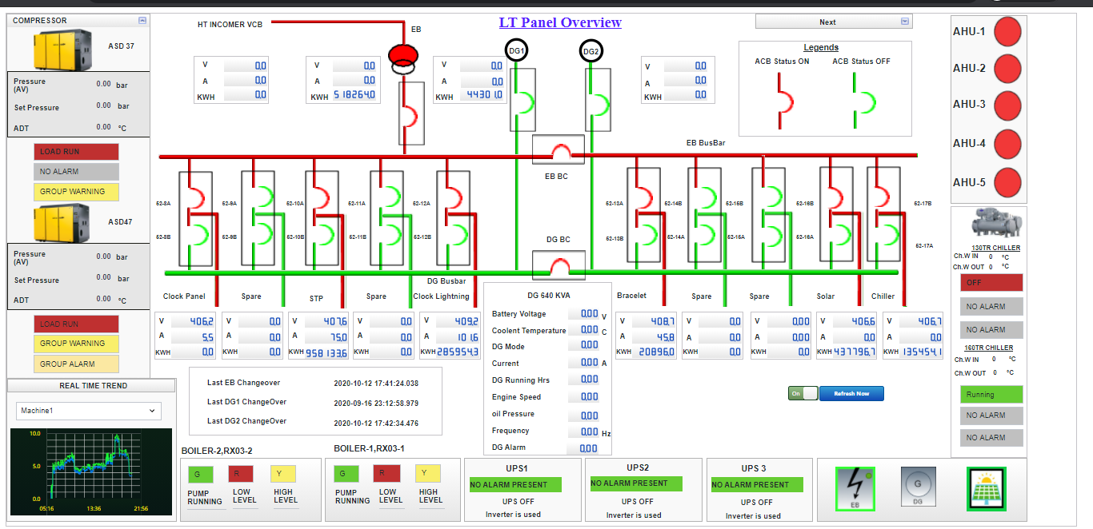
LT Panel OverView

Slide 3
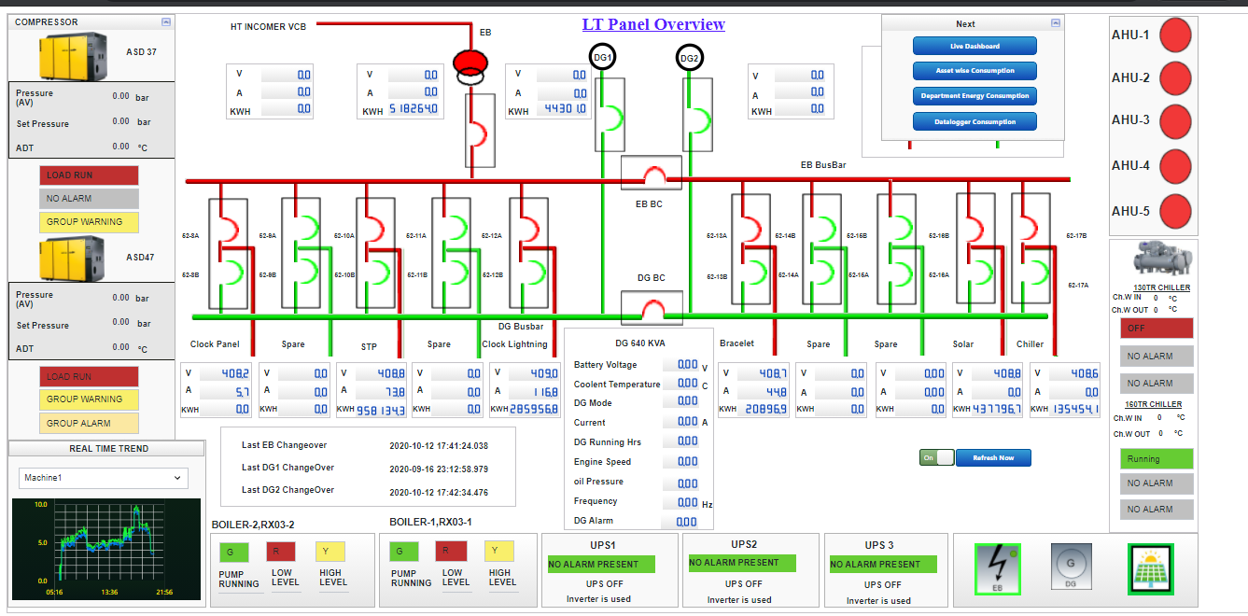
LTPanel Overview with Menu

Slide 4
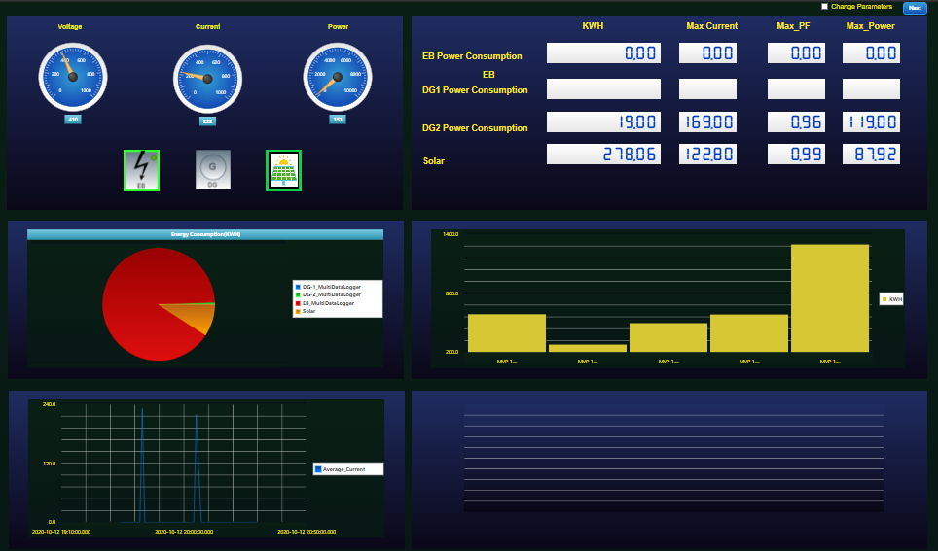
Live Dashboard

Slide 5
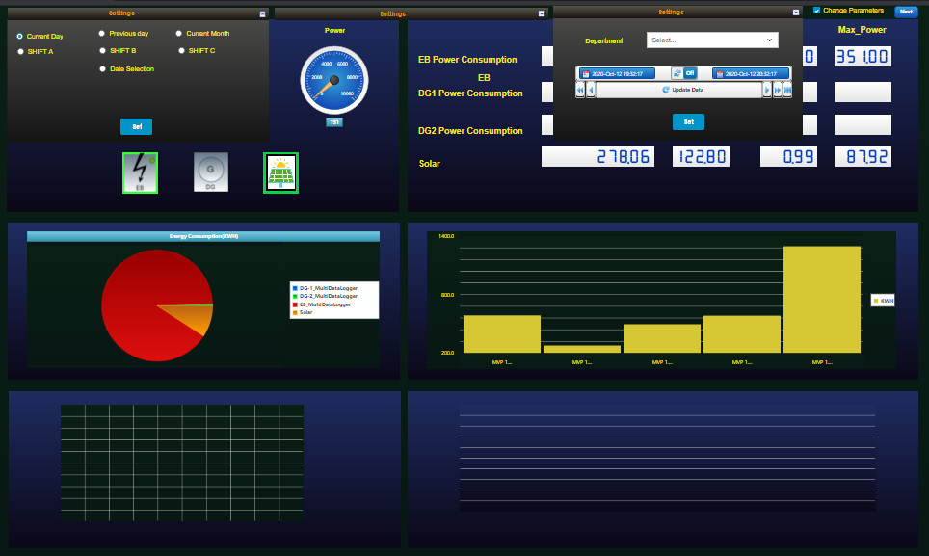
Live Dashboard with Parameters

Slide 6
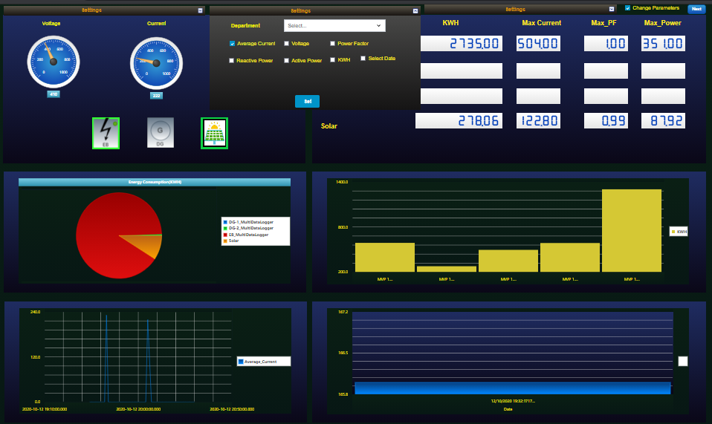
Live Dashboard with Parameters

Slide 7
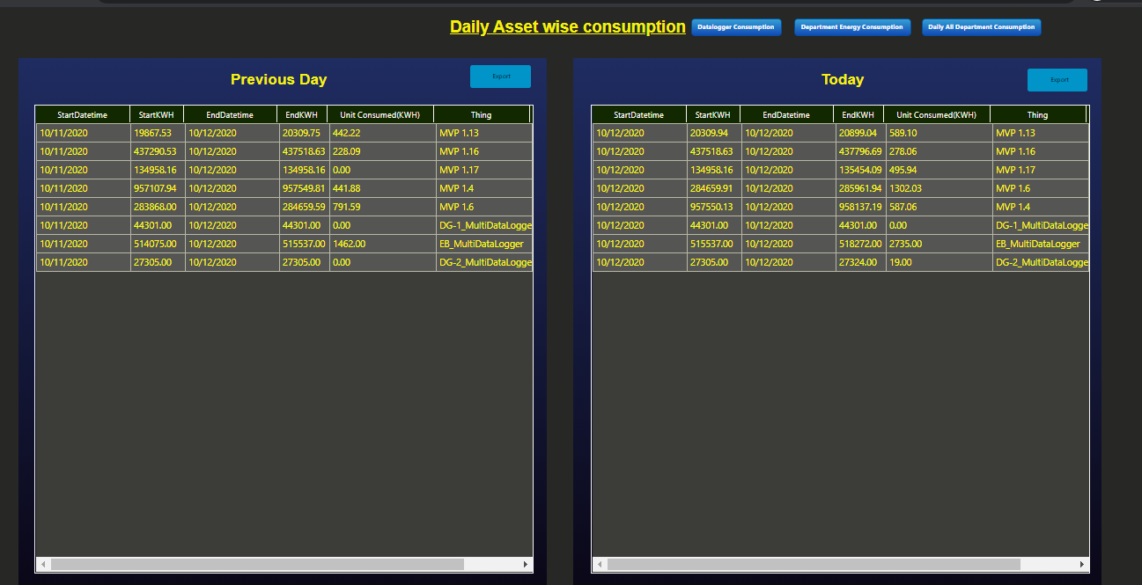
Daily Asset wise consumption

Slide 8
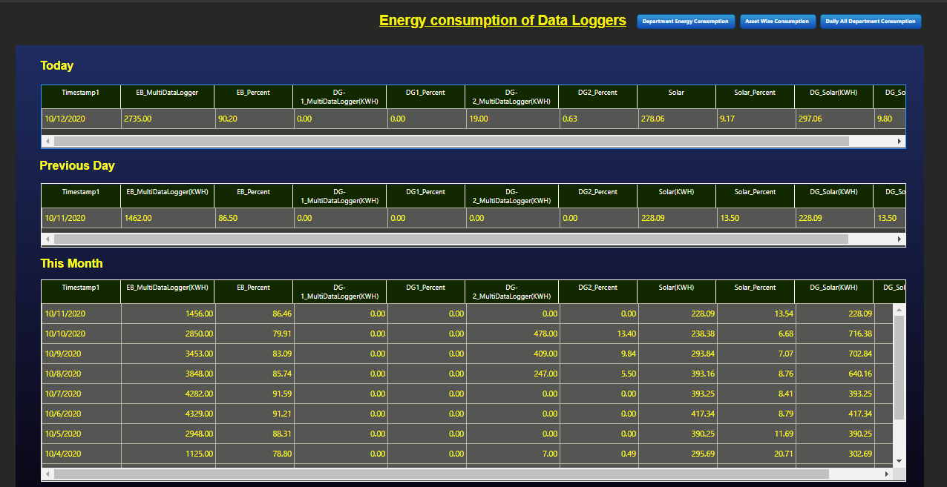
Data Loggers KWH

Slide 9
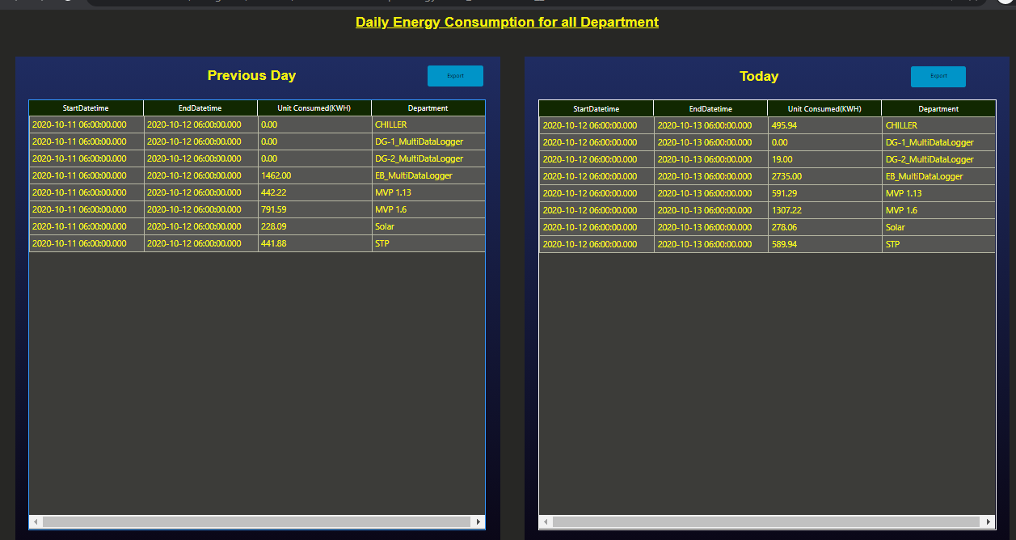
Department Daily Energy Consumption

Slide 10
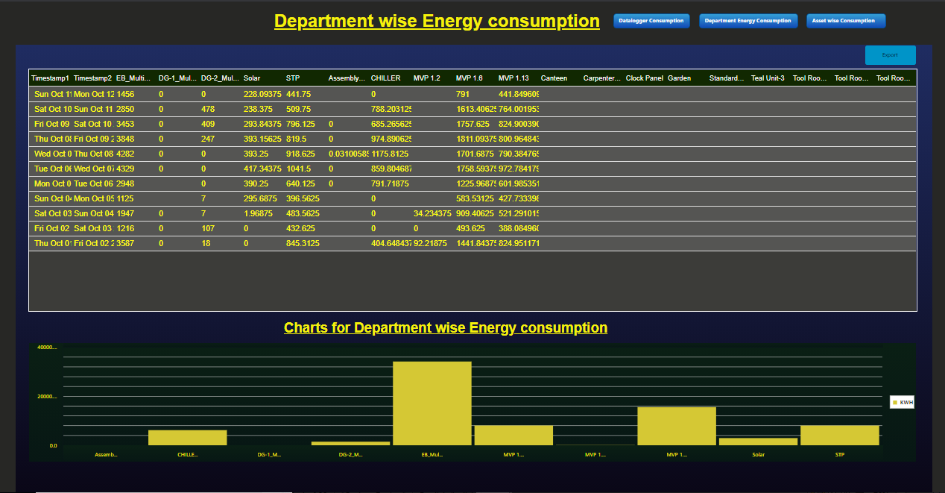
Department Wise Energy Consumption

Slide 11
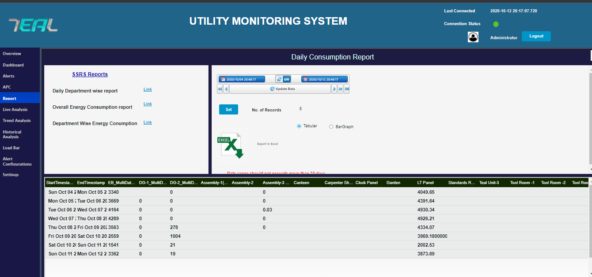
Daily consumption Report in Table format

Slide 12
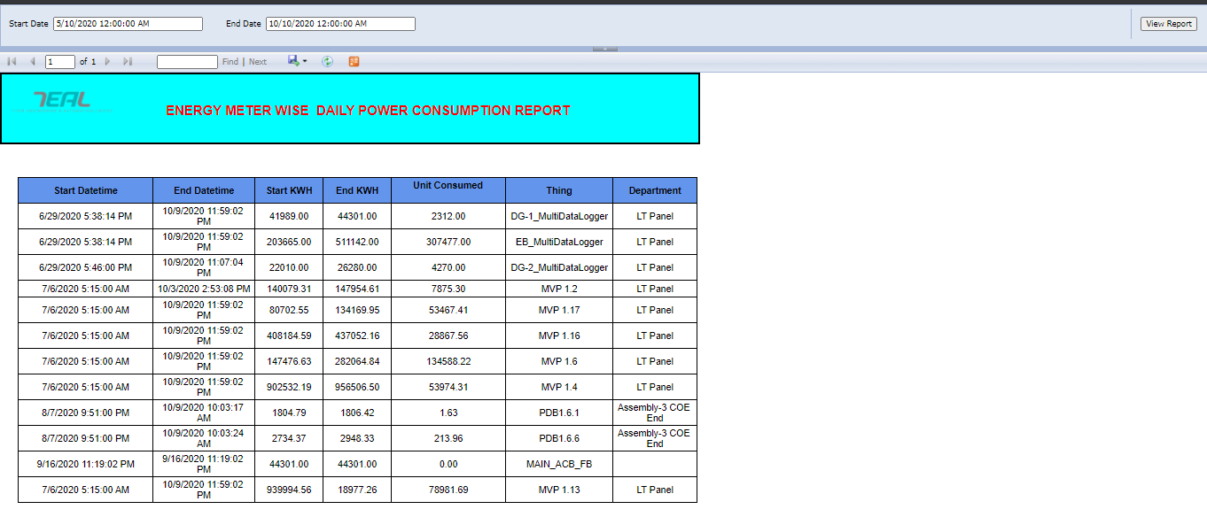
Energy Meter Daily KWH Report

Slide 13
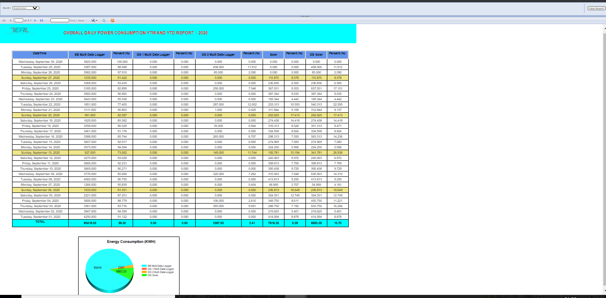
Overall Daily Consumption YTM and YTD Report

Slide 14
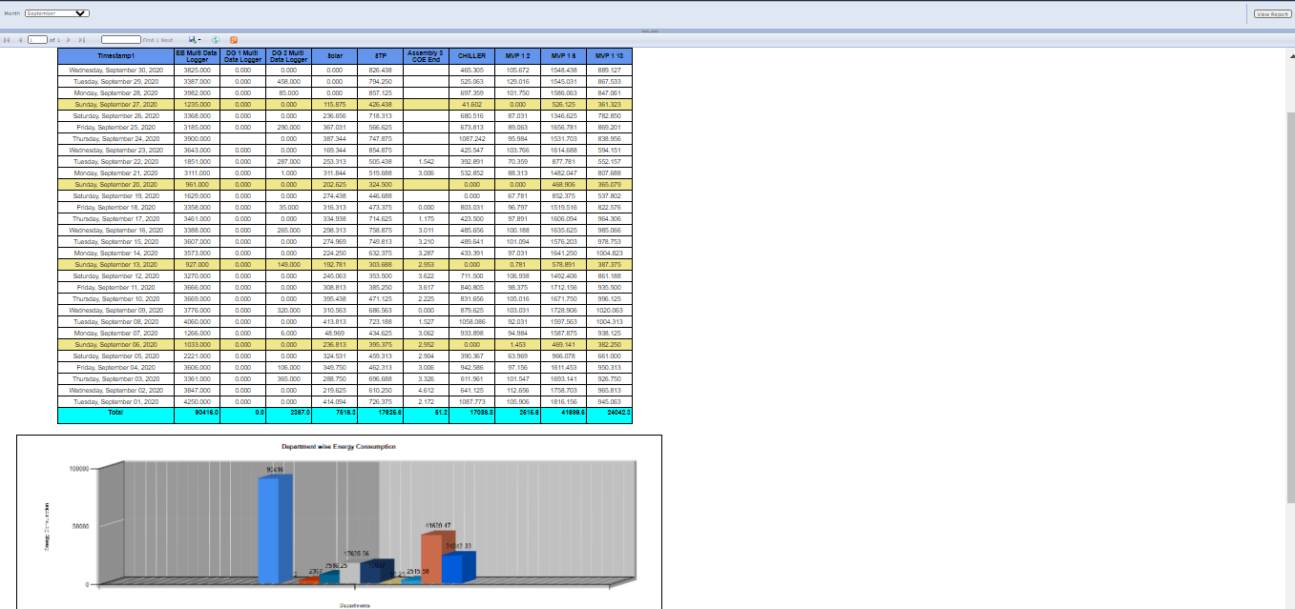
Daily Power Consumption Report

Slide 15
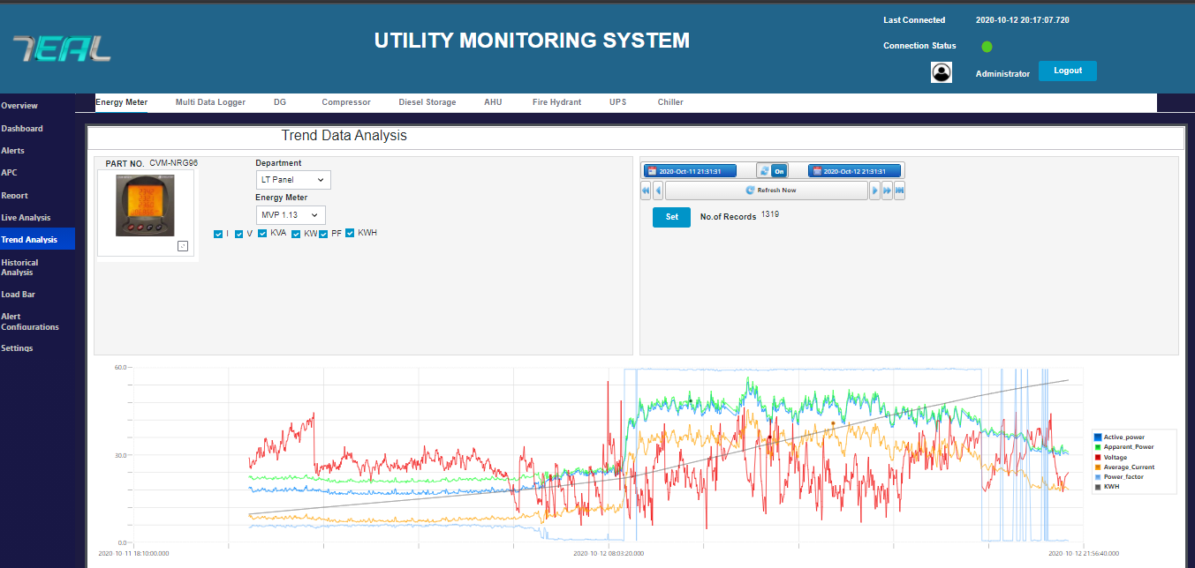
Trend Analysis

Slide 16
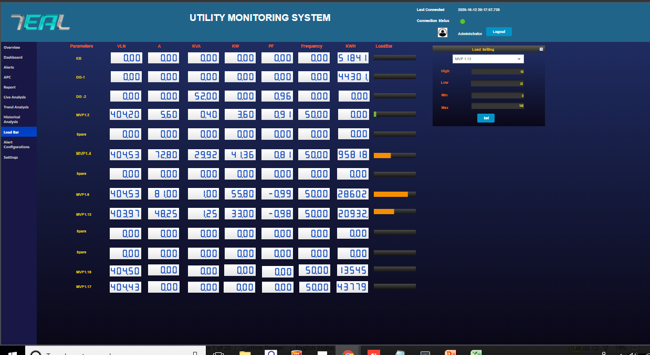
Load Bar

